Slide 1
Nasdaq: AUTL
Developing Next Generation Programmed T Cell Therapies
January 2021

Slide 2
Disclaimer
These slides and the accompanying oral presentation contain forward-looking statements within the meaning of the “safe harbor” provisions of The Private Securities Litigation Reform Act of 1995, including statements about the safety, therapeutic potential and commercial opportunity of AUTO1 and AUTO3 and the future clinical development of AUTO1 and AUTO3 including progress, expectations as to the reporting of data, conduct and timing; the Company's plans to develop and commercialize its other product candidates and next generation programs including statements regarding the timing of initiation, completion of enrollment and availability of data from the Company’s current preclinical studies and clinical trials; the Company’s commercialization, marketing and manufacturing capabilities and strategy; the impact of the ongoing COVID-19 pandemic on the Company’s operations and clinical trials; and the restructuring program and Autolus’ expected cash savings as a result of the restructuring program and operational changes. All statements other than statements of historical fact contained in this presentation, including statements regarding the Company’s future results of operations and financial position, business strategy and plans and objectives of management for future operations, are forward-looking statements. In some cases, you can identify forward-looking statements by terms such as “may,” “should,” “expects,” “plans,” “anticipates,” “could,” “intends,” “target,” “projects,” “contemplates,” “believes,” “estimates,” “predicts,” “potential” or “continue” or the negative of these terms or other similar expressions. These statements involve known and unknown risks, uncertainties and other important factors that may cause the Company’s actual results, performance or achievements to be materially different from any future results, performance or achievements expressed or implied by the forward-looking statements. Factors that may cause actual results to differ materially from any future results expressed or implied by any forward-looking statements include the risks described in the “Risk Factors” section of the Company’s Annual Report on Form 20-F for the year ended December 31, 2019, as amended, as well as those set forth from time to time in the Company’s subsequent SEC filings, available at www.sec.gov. All information contained herein is as of the date of the presentation, and the Company undertakes no obligation to publicly update any forward-looking statement, whether as a result of new information, future events, or otherwise, except as required by law. You should, therefore, not rely on these forward-looking statements as representing the Company’s views as of any date subsequent to the date of this presentation.
Certain data in this presentation was obtained from various external sources. Such data speak only as of the date referenced in this presentation and neither the Company nor its affiliates, advisors or representatives make any representation as to the accuracy or completeness of that data or undertake to update such data after the date of this presentation. Such data involve risks and uncertainties and are subject to change based on various factors.

Slide 3
Lead Clinical Programs
Striving for best-in-class therapies
3

Slide 4
Driving value with potential best-in-class adult ALL program
Plan to partner AUTO3 ahead of progressing into next phase of development
Additional value steps in T cell lymphoma and first solid tumor indication
Broad preclinical pipeline of next generation programs expected to transition to clinical stage in 2021/2022
Scalable, fully enclosed manufacturing platform
  Full data for AUTO1 – AL-1 study in adult expected in 2022
Focusing on delivering AUTO1, a potentially transformational treatment for Adult Acute Lymphoblastic Leukemia (ALL), as well as exploring activity in additional
B-cell malignancies
AUTO1 data in PCNSL and NHL expected in Q4 2021, AUTO1/22 in pALL expected in Q4 2021

Slide 5
Broad pipeline of clinical programs
Designed to address limitations of current T cell therapies
PRODUCT
INDICATION
TARGET
PHASE 1/2
PIVOTAL*
AUTO1
Adult ALL
CD19
ALLCAR19
AUTO1-AL1
AUTO1
NHL †
CD19
ALLCAR19
AUTO1
PCNSL † †
CD19
CAROUSEL
AUTO1/22
Pediatric ALL
CD19 & CD22
CARPALL
AUTO3
DLBCL
CD19 & CD22
ALEXANDER
To be partnered
AUTO4
TRBC1+ Peripheral TCL
TRBC1
LibrA T1
B Cell Malignancies
T Cell Lymphoma
*Subject to confirmation by regulatory authorities
† Non-Hodgkin lymphoma
† † PCNSL = Primary CNS Lymphoma

Slide 6
Adult Acute Lymphoblastic Leukemia
AUTO1— Potential as a standalone therapy
6

Slide 7
No approved CAR T therapy for adult ALL patients
Successful therapy requires high level of activity and sustained persistence paired with good tolerability
HIGH UNMET MEDICAL NEED
  Combination chemotherapy enables 90% of adult ALL patients to experience CR, but only 30% to 40% will achieve long-term remission
  Median overall survival is < 1 year in r/r ALL
  Only redirected T cell therapy for adult patients is blinatumomab
  CAR T therapies are highly active, but require subsequent allograft to achieve durability
  Patients are generally more fragile with co-morbidities, yet CAR T toxicities in this setting have been notable with high incidences of severe CRS and cases of fatal neurotoxicity
  Opportunity to conduct further clinical study for second line treatment label increasing addressable patient population
  FDA GRANTED AUTO1 ORPHAN DRUG DESIGNATION FOR ALL
ALL is a significant opportunity
  Up to 8,400* new cases of
  adult ALL diagnosed yearly worldwide
  Estimated R/R patients in
  US & EU 3,000 addressable patient population in last
  line setting
*SEER and EUCAN estimates (respectively) for US and EU epi

Slide 8
AUTO1 is designed for durable responses and low incidences of severe CRS
Key features differ to conventional CARs
inc
CONVENTIONAL CD19 CARS
AUTO1
Approved and late clinical stage CD19 CAR Ts use identical high affinity CD19 binder (FMC63)
FMC63 has a very slow off-rate, consequently CAR T cells have a long interaction with the target
Leads to over-activation, exhaustion and high-grade CRS and neurotoxicities
AUTO1 has an optimized CD19 CAR with a lower (40x) affinity for CD19
Fast off-rate* efficiently delivers a kill, and disengages rapidly like a normal T cell
Leads to enhanced activity and persistence with favorable tolerability
*Ghorashian S, Pule MA, Amrolia P et al. Nature Medicine 2019

Slide 9
AUTO1 has potential for transformational outcomes in adult ALL
Data presented at ASH 2020, with a data cut-off date November 12, 2020
High level of sustained CRs, achieved without subsequent stem cell transplant
Durability of remissions highly encouraging
– Across all treated patients, event free survival (EFS) at six and 12 months was 69% and 52%, respectively
AUTO1 well tolerated, despite heavily pre-treated patients with high disease burden
– No patients experienced ≥ Grade 3 cytokine release syndrome (CRS) as of data cut-off date
Ph1b/2 potential pivotal study underway, expect full data in 2022
– Escalating COVID-19 pandemic is continuing to impact study conduct
Adult ALL represents a sizeable market opportunity addressable with limited commercial footprint

Slide 10
AUTO1 is well tolerated, even in patients with high disease burden
CRS (Lee Criteria)
Neurotoxicity (ICANS*)
≥ Grade 3 Neutropenia
CRS (any) in 10/20
Grade 2 in 7/20
≥ Grade 3 CRS in 0/20
ICANS (any) in 4/20
Grade 2 in 1/20
Grade 3 in 3/20
7/20 preceded treatment
8/17 at D28, most resolving by Month 2-3
Cytokine Release Syndrome (CRS)
50% developed CRS G1 and G2, all patients who developed G2 CRS had high disease burden
B-ALL
No high grade CRS observed
Tocilizumab was used in 7/20 patients (35%)
Neurotoxicity (ICANS)
ICANS was reported in 4/20 patients: all had ≥ 50% blasts; all cases were preceded by CRS
3/4 cases resolved to G1 in <24h with steroids, 1/4 cases resolved to G1 in 72h with steroids
7/20 patients died on study:
2/20 died from progressive
B-ALL and 1 died
post-progression from
allo-transplant-related complications (VOD/sepsis)
4/20 died from infection: 2 due to invasive fungal, 1 MDR-pseudomonas, 1 of COVID-19
* Immune Effector Cell Associated Neurotoxicity Syndrome CRS & NT will be graded using the ASTCT/ASBMT Consensus Grading (Lee et al. 2019)

Slide 11

Responses are durable without need for transplant
MRD negative CRs ongoing past 24 months observed
ALL-29
ALL-24
MEDIAN FOLLOW-UP 16.9 MONTHS (RANGE 0.6 – 30.5 M)
PATIENT ID
ALL-22
ALL-20
Complete Remission
ALL-19
Not Evaluable
ALL-18
MRD negative CR
(PCR/Flow)
ALL-17
CLOSED PROCESS
ALL-16
Ongoing Disease
ALL-15
CD19 -ve Relapse
ALL-14
CD19 +ve Relapse
ALL-13
ALL-12
Allogenic BMT
ALL-11
Death
ALL-09
ALL-07
ALL-06
OPEN PROCESS
ALL-05
ALL-03
ALL-02
ALL-01
0
3
6
9
12
15
18
21
24
27
30
33
DURATION (MONTHS)

Slide 12
Event-free survival of 52% at 12 months supports AUTO1’s unique profile
 |  | All patients Est [95% CI] | Closed processɫ Est [95% CI]
 | N* | 19 | 13
 | ORR | 84% | 92%
 | MRD Neg CR | 84% | 92%
DOR
 | Median | Not reached | Not reached
 | 6 months | 81% [52%, 94%] | 83% [48%, 96%]
 | 12 months | 68% [39%, 85%] | 65% [31%, 85%]
EFS
 | Median | Not reached | Not reached
 | 6 months | 69% [43%, 85%] | 85% [52%, 96%]
 | 12 months | 52% [28%, 71%] | 60% [29%, 81%]
OS
 | Median | Not reached | Not reached
 | 6 months | 68% [43%, 84%] | 85% [51%, 96%]
 | 12 months | 63% [37%, 80%] | 76% [43%, 92%]
AUTO1: Efficacy Overview
*N = All patients with at least M1 follow-up or RIP prior to Month 1
ɫ Closed process is the commercial manufacturing process
Event = death or morphological relapse
DOR, EFS and OS data are preliminary considering the small n

Slide 13
AUTO1 has potential as a standalone therapy
A cross study comparison of AUTO1 vs current standard of care
 | AUTO1¹ |  | Standard of Care
 | All patients |  | Blinatumomab² | Inotuzumab³
Patient Numbers | 19 |  | 271 | 218
CR Rate | 84% |  | 44% | 80.7%
EFS 6m (EFS 12m) | 69% (52%) |  | 31% | mPFS 5m
CRS ≥ Grade 3† | 0% |  | 3% | 0%
Neurotox ≥ Grade 3† | 15%* |  | 13% | 0%
Other notable toxicities |  |  |  | 14% Hepatic VoD
* Observed in patients with
> 50% tumor burden
1. Roddie et al., ASH 2020
2. Kantarjian et al., 2017
3. Kantarjian et al., 2016
†20 patients evaluable for safety
Approximately 50% of blinatumomab and inotuzumab patients received subsequent HSCT
Veno-Occlusive Disease (VoD) during treatment and following subsequent HSCT, with the latter causing a higher post-HSCT non-relapse mortality rate, has limited inotuzumab uptake

Slide 14
Adult ALL is a promising commercial opportunity with limited competition
R/R adult ALL is estimated* to be three times the size of r/r pediatric ALL
AUTO1 r/r Adult ALL
r/r Pediatric ALL
Estimated R/R patients
~3,000
addressable patient
population
in last line setting
Estimated R/R patients
~1,000
addressable patient
population
in last line setting
ADDITIONAL POTENTIAL FOR AUTO1 TO MOVE TO 1ST AND 2ND LINES **, WHICH INCREASES THE ADDRESSABLE PATIENT POPULATION TO APPROX. 5,000 ADULT ALL PATIENTS
*Company estimate, based on US, EU5 and Japan
**Subject to successful clinical progress
14

Slide 15
Blincyto and Besponsa sales suggestive of a meaningful opportunity in adult ALL
+ 21%
Blincyto sales price estimated to be $175k (based on 1.7 cycles) resulting in approx. 1,400 -1,800 commercial patients (includes pediatric patients)
Opportunity to address entire relapse / refractory adult ALL setting, representing 3,000 patients across US, EU5 and Japan
Novartis employs orphan-based differential pricing in the US with Kymriah in pediatric ALL priced at $475k compared to $375k in DLBCL
Global Sales $m
Reported Blincyto Sales* Estimated Besponsa sales
*As per Amgen SEC quarterly filings

Slide 16
Preliminary Ph1 data supports development as a standalone therapy
AUTO1 is the first Autolus program to move into a pivotal program
Pivotal program,
AUTO1-AL1, in adult ALL enrolling with full data targeted in 2022
  CTA approved
  by the MHRA
  in January 2020 and US IND accepted by
  the FDA in
  April 2020
Ph1b run-in component, prior to single arm Ph2 pivotal study
100 relapsed/refractory adult ALL patients
Primary endpoint: Overall Complete Response Rate (CR/CRi)
Secondary endpoints: include MRD-negative CR EFS and DoR

Slide 17
Capitalizing on the unique profile of AUTO1 in adult ALL
Exploration of AUTO1 activity in additional B-Cell malignancies
PRODUCT
INDICATION
TARGET
PHASE 1
PIVOTAL
AUTO1
Adult ALL
CD19
ALLCAR19
AUTO1-AL1
AUTO1
iNHL & CLL
CD19
ALLCAR19 ext.
Primary CNS Lymphoma*
CD19
AUTO1
CAROUSEL
AUTO1/22
Pediatric ALL
CD19 & CD22
CARPALL ext.
*Primary CNS lymphoma annual incidence approx. 1,400 cases in the US. Reference: Keva Green; Jeffery P. Hogg https://www.ncbi.nlm.nih.gov/books/NBK545145/.

Slide 18
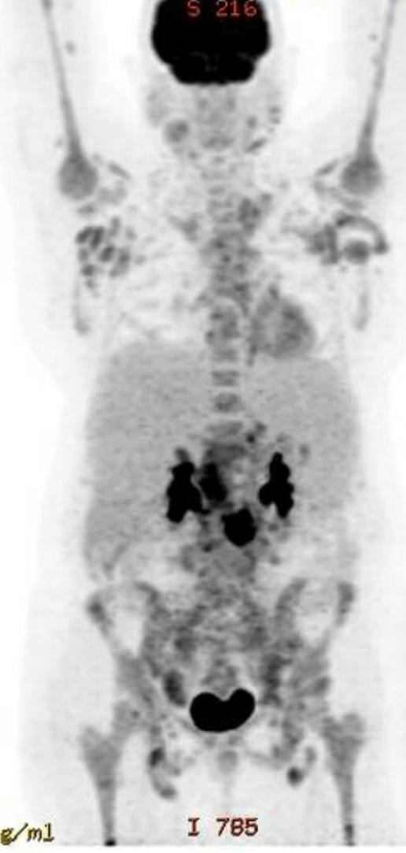
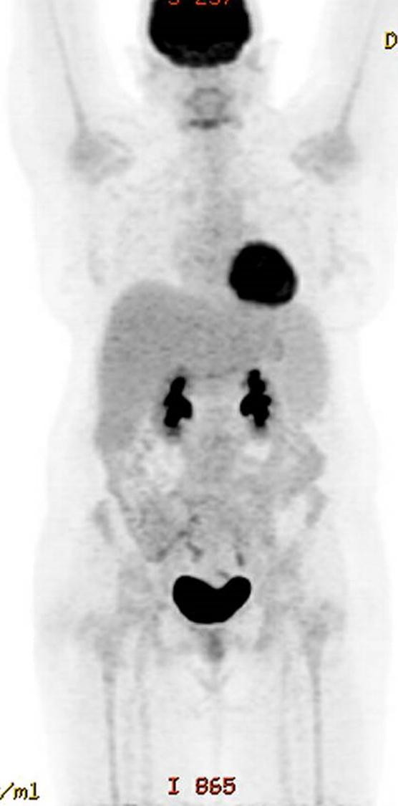
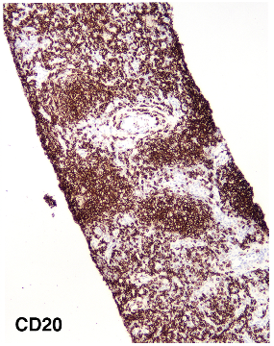
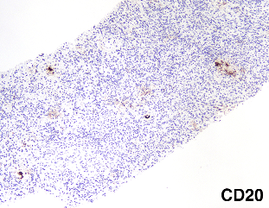
Initial data suggest encouraging signals in other B cell malignancies
ALLCAR19 Study extension Cohort 1: Extending to Indolent NHL
TOXICITY
RESPONSES BASED ON LUGANO CRITERIA AND IHC (CD20)
 | N = 4
CRS Any grade ≥ Grade 2 | 3/4 0/4
Neurotoxicity (ICANS) Any grade | 0/4
≥ Grade 3 Neutropenia Day -6 Day 28 | 0/4 0/4
 | N = 4
CMR | 4/4
PR | 0/4
SD | 0/4
PD | 0/4
PRE-LD
MONTH 1
ENGRAFTMENT
Serial LN Biopsies, CD20 by IHC, Dr Teresa Marafioti, UCL

Slide 19
Diffuse Large B Cell Lymphoma
AUTO3 — tailored for DLBCL
19

Slide 20

AUTO3: First CD19 and CD22 targeting bicistronic CAR
Gamma Retroviral-Based Vector with RD114 Pseudotype
AUTO3 is designed to achieve a high level of clinical activity, favourable safety profile and low rate of relapses due to CD19 antigen loss
Design features:
  Dual antigen targeting
  Two independent CARs delivered in single retroviral vector
  Humanized binders
  CD22 CAR with novel pentameric spacer
  OX40/41BB costimulatory domains designed to improve persistence
  Independently target CD19 and CD22
aCD19
scFV
aCD22
scFV
-S-S-
CD8aSTK
COMP
-S-S-
-S-S-
-S-S-
-S-S-
-S-S-
PLASMA MEMBRANE
OX40
41BB
TCRz
TCRz
aCD19CAR
aCD22CAR

Slide 21
DLBCL: approved CAR Ts are unable to penetrate outpatient setting
Creates significant opportunity for AUTO3 with potential to go where patients are treated
PERCENTAGE OF PATIENTS WHO CURRENTLY RECEIVE A CAR T IN OUTPATIENT OR INPATIENT SETTING
97% of patients receive approved CAR Ts as inpatients in CoEs * because of
  the high rate of severity of toxicities and
  the need for intensive patient management
In the Outreach study**, 63% of patients treated with liso-cel in an outpatient setting required hospitalization
AUTO3 is designed to have best-in-class safety profile potentially best suited for outpatient use
Source: Komodo Health, ASCO 2020: 8037
* Center of Excellence
**Initial results from the Outreach Study, ASH 2020

Slide 22
Low rates of CRS and low rates of NT observed across all dose levels
Cytokine Release Syndrome and Neurotoxicity — by cohort
 | 50 x10⁶ AUTO3 no pem (N=4) | 50 x10⁶ AUTO3 D14 pem (N=3) | 150-450 x10⁶ AUTO3 D14 pem (N=8) | 150-450 x10⁶ AUTO3 D-1 pem Inpt (N=17) | 150-450 x10⁶ AUTO3 D-1 pem Outpt (N=17) | Total (N=49)
SAFETY
CRS All Grades | 1 | 0 | 4 | 5 | 7 | 17 (35%)
CRS ≥ Grade 3 | 0 | 0* | 0 | 0 | 1 | 1 (2%)
NTX All Grades | 1 | 0 | 0 | 1 | 1 | 3 (6%)
NTX ≥ Grade 3 | 1 | 0 | 0 | 0 | 1 | 2 (4%)
No prophylactic measures of any kind, no patients received steroids. Eight patients received tocilizumab (16%).
Median time to CRS 2 days (1-36). Median duration 3 days (1-19).
No NT of any grade in patients that achieved CR, all NT atypical in context of tumor progression with zero to minimal CAR T expansion in peripheral blood.
  1st case of NT (G3): Day 53. Duration 5 days (G2). The same symptoms of facial/muscle weakness occurred > 10 years ago without specific diagnosis. Resolved.
  2nd case of NT (G2): Day 21. Duration 6 days. AMS* associated with sepsis and narcotic. Resolved.
  3rd case of NT (G4): Day 10. Encephalopathy associated with sepsis, hyponatremia, metabolic acidosis, and multiorgan failure. Patient died of disease progression and multiorgan failure.
* 1 patient who had no CRS with primary infusion, developed G3 CRS (severe hypoxia) with re-treatment 1 year later which happened in a setting of no CAR T expansion and significant disease burden in lung that had been treated with radiation
CRS grading as ASCT/ASBMT (Lee et al 2019) Data Cut-off Date: 30-Oct-2020

Slide 23
Efficacy seen across all dose ranges
Response data by cohort
 | 50 x10⁶ AUTO3 no pem (N=4) | 50 x10⁶ AUTO3 D14 pem (N=3) | 150-450 x10⁶ AUTO3 D14 pem (N=8) | 150-450 x10⁶ AUTO3 D-1 pem Inpt (N=17) | 150-450 x10⁶ AUTO3 D-1 pem Outpt (N=17) | Total (N=49)
N Evaluable* | 4 | 2 | 8 | 15 | 14 | 43
ORR (CR+PR) | 2 (50%) | 2 (100%) | 5 (63%) | 10 (67%) | 9 (64%) | 28 (65%)
CR | 1 (25%) | 1 (50%) | 4 (50%) | 9 (60%) | 7 (50%) | 22 (51%)
PR | 1 (25%) | 1 (50%) | 1 (13%) | 1 (7%) | 2 (14%) | 6 (14%)
150-450 x 10⁶, Day -1 pem (N=29 evaluable): ORR 66%, CR rate 55%
Doses ≥ 300 x 10⁶, CR rate of 62% (n=26)
Dose of 450 x 10⁶, CR rate of 73% (n=15)
* Evaluable = PET positive disease prior to start of pre-conditioning and infused at least 28 days prior to data Cut-off date
Response evaluation per Lugano 2014 criteria
ORR = Overall response rate; CR = Complete response; PR = Partial response
Data Cut-off Date: 30-Oct-2020

Slide 24
Outpatient infusion of AUTO3 appears feasible
Healthcare utilization in outpatient cohort
150-450 x10⁶ AUTO3
D-1 pem Outpt
(N=17)
AUTO3 infusion inpatient
AUTO3 infusion outpatient
Admission post AUTO3
ICU admission
4
13
5 (38%)
0
5 patients received AUTO3 outpatient but admitted (due to FN* and CRS)
Median duration of hospitalisation was 5 days (range 1-9 days)
MAJORITY OF PATIENTS RECEIVING AUTO3 IN THE OUTPATIENT SETTING
DID NOT REQUIRE HOSPITAL ADMISSION
THOSE PATIENTS ADMITTED WERE EASILY MANAGED, WITH NO PATIENTS REQUIRING ICU CARE

Slide 25
AUTO3 continues to show differentiated product profile
Data presented at ASH 2020, with data cut-off date October 30, 2020
Key Ph1 observations:
  High level of complete remissions (CR) of 51% overall
  At the highest dose level of 450M cells the CR rate was 73%
  Very low levels of high-grade CRS and neurotoxicity
  AUTO3 administration together with the pembrolizumab dosing regimens (D-1 and D14/D35/D56) were well tolerated
  Among the five patients who achieved a CR having received 3 doses of pembrolizumab, none had progressed as of the data cut-off date
  Demonstrated feasibility to administer AUTO3
  in outpatient setting
Path forward for development of AUTO3
  Ph2 designs under evaluation:
    3L r/r DLBCL setting
    2L/3L transplant ineligible DLBCL setting
  Planned Ph2 dosing regimen
    Dose range of 150M to 450M cells, as patients benefitted from therapy at 150M, 300M and 450M cell dose levels
    3 doses of pembrolizumab with a schedule of D-1, D28, D56
  Implement manufacturing process enhancements (incl. stable cell line for vector manufacturing)
COMPANY INTENDS TO PARTNER AUTO3, AHEAD OF PROGRESSING
INTO THE NEXT PHASE OF DEVELOPMENT
25

Slide 26
T Cell Lymphoma
AUTO4 and AUTO 5 — tailored for T Cell Lymphoma
26

Slide 27
T Cell Lymphoma
No standard of care after first relapse and no T cell therapy approved
AUTOLUS USES THREE KEY ELEMENTS TO
ADDRESS T CELL LYMPHOMA’S—AUTO4, AUTO5 AND A COMPANION DIAGNOSTIC TEST
T cell lymphoma is an aggressive disease with a very poor prognosis
for patients
Median 5 yrs OS: 32%
Standard of care is variable and often based on high-dose chemotherapy and stem cell transplants
A large portion of T cell lymphoma patients are refractory to or
relapse following treatment with standard therapies
T cell lymphomas have not benefited from advances in immunotherapeutic approaches
> ~40% of T cell lymphomas are TRBC1+
  AUTO4
  TRBC1+
  patients
  TRBC1 programmed T cell product candidate
Designed to stratify patients into TRBC1 and TRBC2 derived
cancers
Companion Diagnostic Test
  AUTO5
  TRBC2+
  patients
  TRBC2 programmed T cell product candidate
> ~60% of T cell lymphomas are TRBC2+

Slide 28
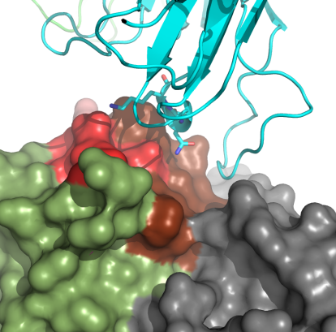
Unique targeting of TRBC1 & TRBC2 opens new therapeutic approach
AUTO4/5 in Peripheral T Cell Lymphoma
DIFFERENCES BETWEEN TRBC1 AND TRBC2 ARE SMALL
T CELL RECEPTOR
TRBC1 ANTIBODY
ANTIBODY BINDING DATA
1.5
1.0
0.5
0.0
Jovi-1 mutants
AUTO4 clinical study, LibrA T1, in progress
AUTO5 in late preclinical development
Preclinical study package demonstrating selective binding and anti-tumor activity of TRBC1 and TRBC2 CARs in vitro and in vivo
TRBC1 Binder to TRBC1 TCR
TRBC1 Binder to TRBC2 TCR
Binding Activity (OD 450nm)
TRBC2 Binder to TRBC1 TCR
TRBC2 Binder to TRBC2 TCR
-5 -4 -3 -2 -1 0 1
Antibody Concentration (Log [Ab], µg/ml)

Slide 29
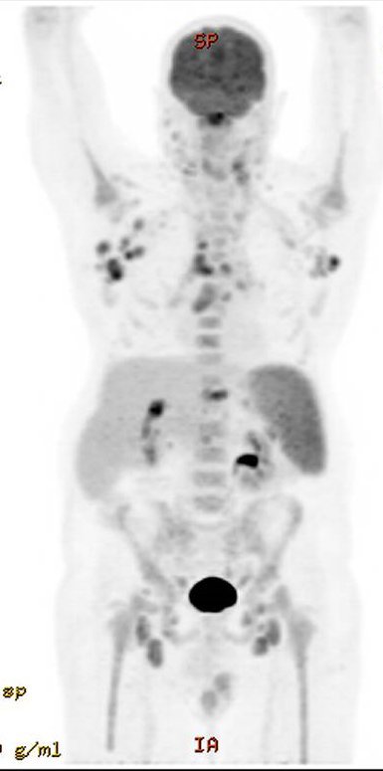
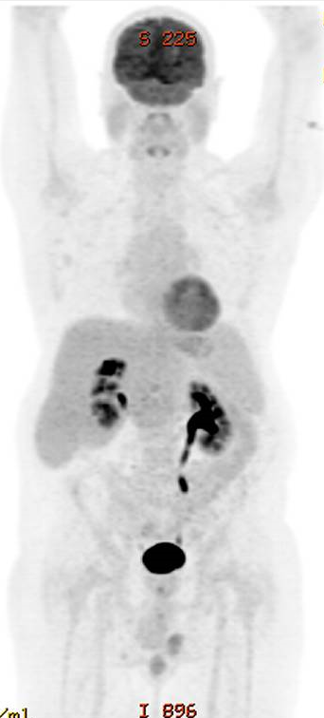
Encouraging signal from AUTO4 treated patient
Clinical outcome of patient 1
57 yr old with Angioimmunoblastic T cell lymphoma
Past treatments include CHOP (CR) & IVE (refractory)
AUTO4 Treatment
  Treated with 25x10⁶ anti-TRBC1 CAR T cells
  No expansion of CAR T cells was noted
  No CRS or neurotoxicity or T-cell aplasia was noted
  Initial PET/CT at one month showed Complete Metabolic Response but subsequently had progression on day 71
AUTO4 Ph1 interim data expected in 2021
BASELINE PET/CT SCAN
PRE-AUTO4 TREATMENT
MONTH 1 PET/CT SCAN

Slide 30
Pipeline
A broad portfolio of next generation modular T cell therapies
30

Slide 31
A broad toolkit which is core to our strategy of modular innovation
Advanced T cell programming
Activity
Enhancement
Modules
Allogeneic
Programming
Modules
Pharmacological
Control Modules
Viral Vector
Advanced Targeting Modules
Viral Vector
CAR
CAR
CTRL
ENH
AUTO
Fast off Rate CARs
Dual Targeting CARs
Avidity Enhancing
Spacers
Logic Gates
Safety Switches
Tunable
CARs
dSHP2
dTGFβ Receptor
Chimeric Cytokine Receptors
Host Immune Cell Recruitment
GvHD
Immune Rejection
AUTO4 AUTO5 AUTO6
AUTO6NG AUTO7 AUTO8
AUTO1
AUTO1/22
AUTO3
AUTO8
AUTO3NG
AUTO6NG
AUTO7
AUTO8
1st clinical program
starts in
H1 2021

Slide 32
Broad pipeline of next generation programs
Designed to address limitations of current T cell therapies
PRODUCT
INDICATION
TARGET
PRECLINICAL
PHASE 1
AUTO1/22
Pediatric ALL
CD19 & CD22
Started Q4 2020
AUTO5
TRBC2+ Peripheral TCL
TRBC2
H2 2021
AUTO6NG
Neuroblastoma; Melanoma; Osteosarcoma; SCLC
GD2
H2 2021
AUTO7
Prostate Cancer
PSMA
H1 2022
AUTO8
Multiple Myeloma
BCMA & CAR X
H1 2021
B Cell Malignancies
T Cell Lymphoma
GD2+ Tumors
Prostate Cancer
Multiple Myeloma
NG = Next Generation, SCLC = Small Cell Lung Cancer

Slide 33
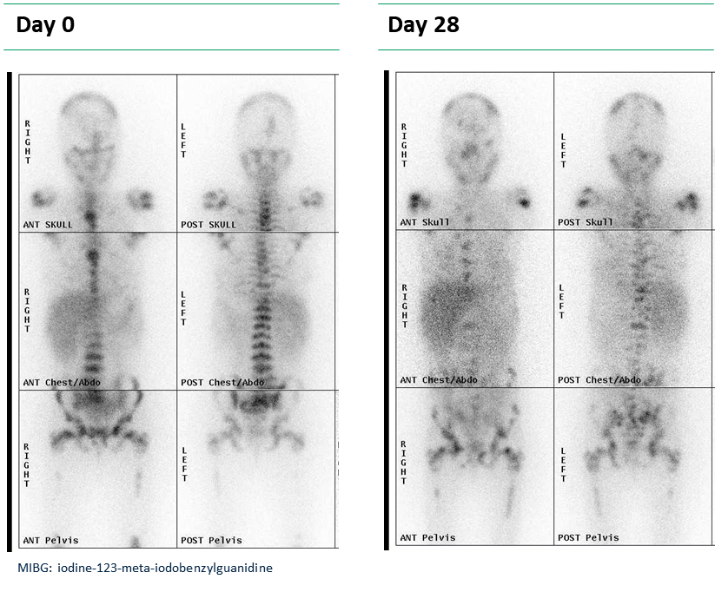
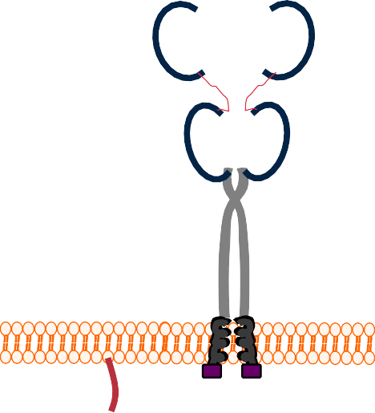
AUTO6 designed to deliver anti-tumor activity without neurotoxicity
AUTO6: GD2-targeted programmed T cell therapy in neuroblastoma
Programmed T cell product candidate:
  New binder design
    Minimize on-target, off-tumor toxicity
    Humanized to reduce immunogenicity
  RQR8 safety switch
Ph1 trial in r/r neuroblastoma
conducted by CRUK in collaboration
with UCL, findings provide
evidence that AUTO6 induces
clinical activity without inducing
on-target off-tumor
toxicity*
DAY 0 DAY 28
GD2 CAR
RQR8
Off-switch
*K. Straathof et al, 25 Nov 2020, Science Translational Medicine, Vol. 12, Issue 571

Slide 34
Modular approach designed to enhance AUTO6NG for solid tumor environment
Next generation programs powered by our proprietary technology toolbox
GD2 CAR
To provide anti-tumor activity and potential to help address neurotoxicity and pain syndrome
dSHP2
To overcome multiple
checkpoint pathways
dnTGFβRII Receptor
To overcome inhibitory effect of TGFβ in microenvironment
AUTO6
SAFETY SWITCH
To eliminate the therapy in the event of unexpected toxicities
Cytokine Signal
IL7 CCR chimeric protein designed to improve CAR T cell persistence
To overcome inhibitory effect of TGFβ in microenvironment
AUTO6
NG
AUTO6NG:
Utilizes GD2 CAR from AUTO6, and is further enhanced to address persistence, control and tumor defenses
Targeting neuroblastoma, osteosarcoma, melanoma and small cell lung cancer amongst others

Slide 35
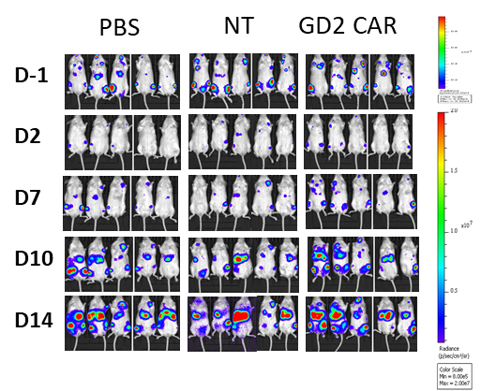
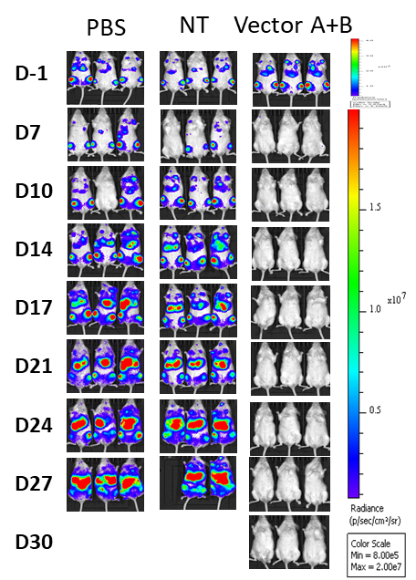
AUTO6NG exhibits potent anti-tumor activity in preclinical model
Extends survival in challenging in vivo model
AUTO6
PBS
CONTROL
AUTO6
PBS
CONTROL
AUTO6NG
AUTO6NG
Achkova, D., et al SITC 2019 (abstract)

Slide 36
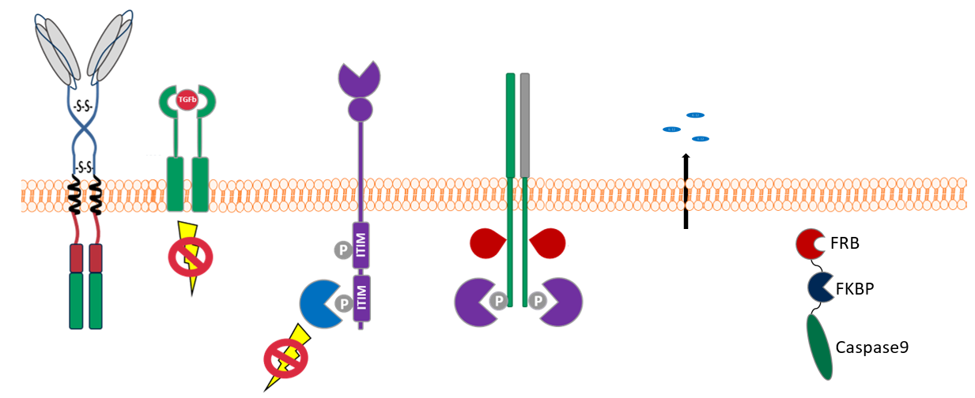
AUTO7 is designed to tackle the complex solid tumor environment
Anti-PSMA humanized CAR T cell for improved persistence and resistance in Prostate Cancer
SS-IL12
dnTGFβRII
α-PSMA CAR
IL7R CCR
dSHP2
RapaCasp¹
PSMA CAR
dnTGFβRII
dSHP2
Cytokine signal
Immune Adjuvant
Safety Switch
Targeting of PSMA expressing tumor cells
Truncated TGFβRII receptor to shield inhibitory effect of TGFβ
Truncated SHP2 to block checkpoint inhibition
Cytokine signal to overcome minimal
co-stimulation
Secretion of IL-12 cytokine to promote host immune activation
To terminate therapy in the event of unexpected toxicities
MODULES DELIVERED USING GAMMA-RETROVIRAL VECTOR

Slide 37
Manufacturing
37

Slide 38
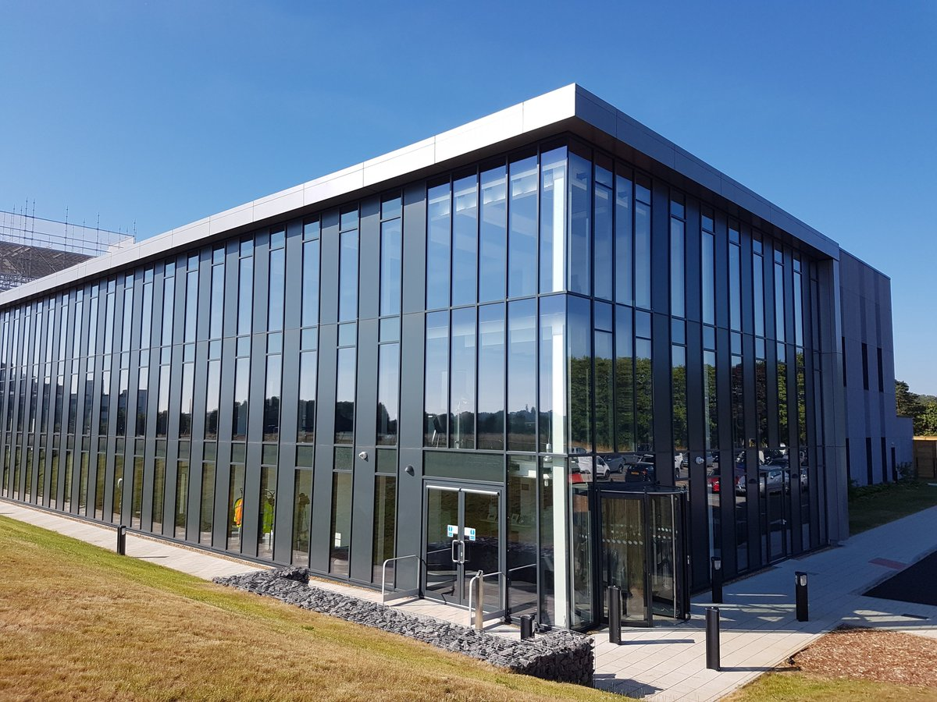
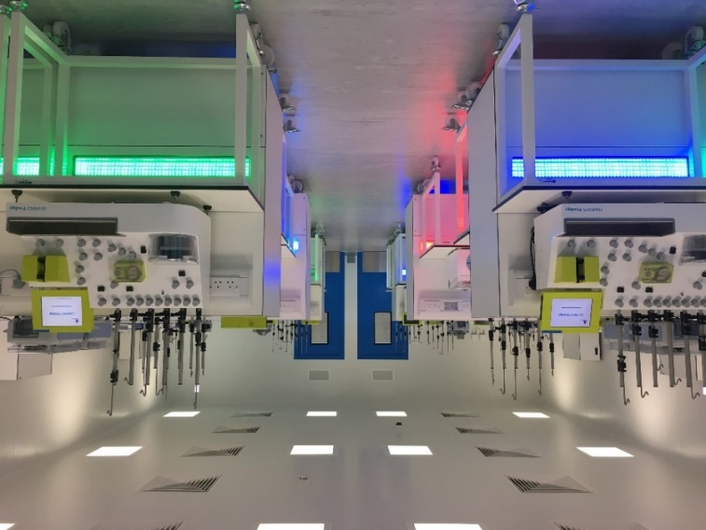

Economical & scalable product delivery platform
Semi-automated and parallel processing
Clinical supply & commercial launch
Multiple cell products can be processed within the same environment
CGT Catapult (UK)
Global clinical supply since Q3 2019
Planned US commercial supply
Collaboration with Alexandria Real Estate Partners (ARE)
Fully scaled commercial site for cell product supply
Planned capacity of 5,000 patients p.a.

Slide 39
Next Steps
39

Slide 40
Multiple clinical milestones anticipated through 2021/2022
PRODUCT | INDICATION | TARGET | PHASE | NEXT MILESTONE
AUTO1 | Adult ALL | CD19 | Pivotal | Ph1 long-term f/u, AL-1 data in 2022
AUTO1 /22 | Pediatric ALL | CD19/CD22 | Phase 1 | Started Ph1 Q4 2020, first data Q4 2021
AUTO1 | B-NHL | CD19 | Phase 1 | Started Ph1 Q3 2020, data updates 2021
AUTO1 | PCNSL | CD19 | Phase 1 | Start Ph1 Q1 2021
AUTO3 | DLBCL | CD19/CD22 | Phase 1 | Ph1 long-term f/u, intend to partner
AUTO4 | TRBC1+ Peripheral TCL | TRBC1+ Peripheral TCL | Phase 1 | Ph1 interim data 2021
AUTO5 | TRBC2+ Peripheral TCL | TRBC2+ Peripheral TCL | Preclinical | Start Ph1 2021
AUTO6 NG | Neuroblastoma; Osteosarcoma; SCLC | GD2 | Preclinical | Start Ph1 2021
AUTO7 | Prostate | PSMA | Preclinical | Start Ph1 H1 2022
AUTO8 | Multiple Myeloma | BCMA/CAR-X | Preclinical | Start Ph1 study H1 2021
ALLO Program | Undisclosed | Undisclosed | Preclinical | Start Ph1 H1 2021
B Cell Malignancies
T Cell Lymphoma
Solid Tumors
Multiple Myeloma
Allogenic

Slide 41
Autolus poised for potential value inflection
AUTO1 and AUTO1/22
  Currently enrolling Autolus’ first Ph1b/2 pivotal program in adult ALL data expected in 2022
  Granted orphan drug designation by the FDA for treatment of ALL
  Pediatric ALL—AUTO1/22 P1 started in Dec 2020, first data expected for Q4 2021
  ALLCAR study extension in iNHL and CLL ongoing, data updates expected in 2021
  Opportunity to develop AUTO1 in Primary CNS Lymphoma, study start planned for Q1 2021
AUTO3
  Company plans to seek a partner for the AUTO3 program
AUTO4
  Ph1 interim data expected in 2021
Multiple Next Generation development candidates entering clinical development in 2021
Cash Balance at September 30, 2020 was $178m. Cash runway into 2022

Slide 42
Thank you
42

